Slide 1
Bridge
William Shiver

Slide 2
What is a Bridge?
Pattern used to decouple an abstraction from its implementation so that the two can vary independently

Slide 3
What is a Bridge?
Abstraction class- Defines the abstraction interface
Refined Abstraction Class-Expands the Abstraction Interface
Implementor -defines the interface for implementation classes
Concrete Implementor -class implements the Implementor interface and defines its concrete implementation

Slide 4
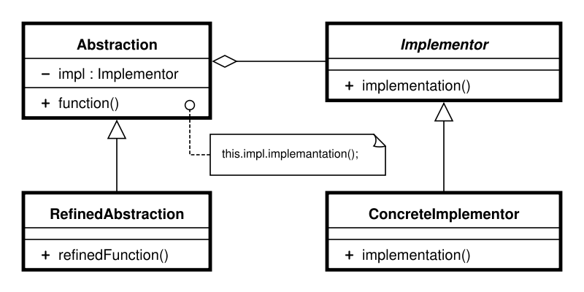
What is a Bridge?

Slide 5
Advantages
Implements run-time binding
Allow multiple implementations to be shared with the same client
Implementations can be changed with out changing the client
Implementations and Abstractions can be changed separately

Slide 6
Disadvantage
Double Indirection-when a pointer can reference another pointer, requiring two dereference operations to get to the original value

Slide 7
Java Example
Switch.java
package structural.bridge; /** * Just two methods. on and off. */ public interface Switch
{
// Two positions of switch.
public void switchOn();
public void switchOff();
}// End of interface

Slide 8
Java Example
Fan.java
package structural.bridge; /** * Implement the switch for Fan */ public class Fan implements Switch
{
private String state= “off”;
// Two positions of switch. public void switchOn()
{ state=“on”; }
public void switchOff()
{ state=“off”; }
}// End of class

Slide 9
Java Example
Bulb.java
package structural.bridge; /** * Implement the switch for Bulb */ public class Bulb implements Switch
{
private String state= “off”;
// Two positions of switch. public void switchOn()
{ state=“on”; }
public void switchOff()
{ state=“off”; }
}// End of class

